Slide 1

Introductions &
Beginner’s Engineering in Red-Light Cameras
Connecticut for responsible Technology, September 1, 2026
Brian Ceccarelli, PE
brian@ceccarelli-pe.com

Slide 2
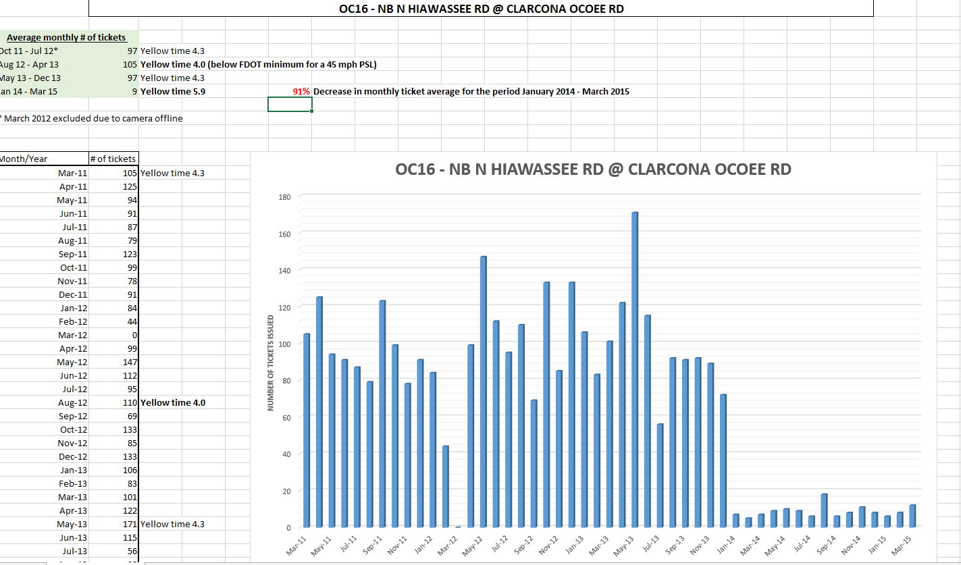

Slide 3
Tell me something about you.
1. Name
2. Age
2. In which city do you live?
3. What is your profession?
4. What is your issue with red-light cameras?
5. What is your issue with speed cameras?
6. What is your issue with bus stop-arm cameras?

Slide 4
I’ll tell you something about me.
1. Name: Brian Ceccarelli
2. Age: 65
3. In which city do I live? Apex, North Carolina
4. What is my profession? Licensed professional engineer. Physicist. Court expert for attorneys in North Carolina, New York, Florida and Georgia

Slide 5
4. What is my issue with red-light cameras?
Fraud scheme penalizing drivers for government engineering errors in the math that computes yellow light durations
5. What is my issue with speed cameras?
Fraud scheme penalizing drivers for the gap between the imprecise engineering of speed limits and state traffic enforcement ordinances
6. What is my issue with bus stop-arm cameras?
Fraud scheme penalizing drivers for the engineering mistakes made by school bus drivers when extending the bus’s stop-arm

Slide 6
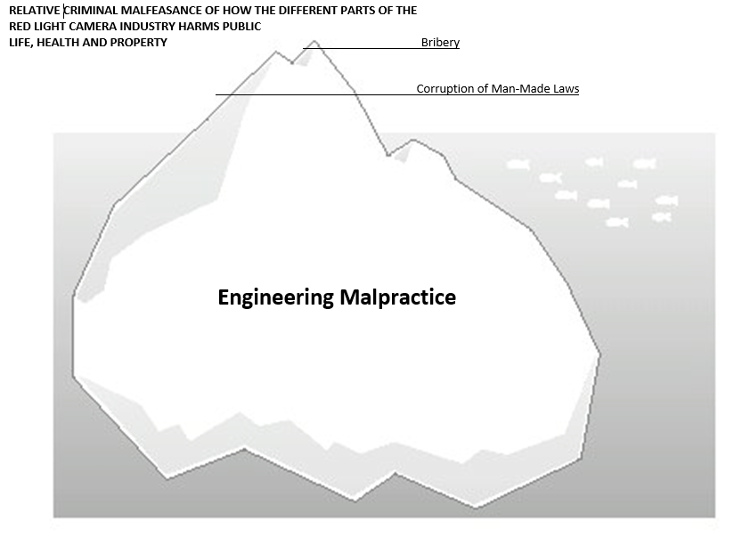
The Real Problem
Photo-enforcement has problems with due process and precedent of “guilty until proven innocent”. Don’t worry about these.
These problems are distractions. Their purpose is to divert people’s time and effort away from attacking the heart of the problem. The heart is engineering malpractice. Camera firms’ and governments’ profit from systematic engineering errors and omissions. They enforce 2 + 2 = 5, but when you experience 2 + 2 = 4, they fine you $65. Because the public blindly trusts government and knows nothing about engineering, photo-enforcement the perfect scam.
Last week I listened to about 50 residents of Fairfield complain about speed cameras. Every complaint was an invalid argument.
Legally speaking, all types of photo-enforcement are a charlatan fraud scheme. A charlatan is like the old-time medicine show operator who comes into town. He impersonates a doctor. He puts on a show which plays on your fears, says a lot of techno-babble to convince you to buy his snake oil. The snake oil does not help. The snake oil never treats the real problem. You keep on buying snake oil. The doctor makes a fortune selling you snake oil. In legal speak, snake oil is a nostrum. Cameras are nostrums.

Slide 7


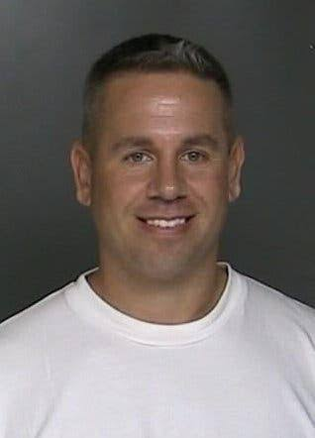




Successful Camera Removals
1. With the help of a state rep and attorney Paul Stam, and NCDOT department director Kevin Lacy, I was able to get rid of all the red-light cameras in North Carolina.
2. Jay Beeber, the director of the National Motorists Association, simply talked to the Los Angeles City Council into removing the red-light cameras. They did. He made the financial argument that prosecuting red-light camera tickets costs more than the city takes in. And the driver is fined $500 per ticket in California.
3. With the help of an activist named Stephen Ruth, attorney Dave Raimondo and I were able to get remove of all red-light cameras from Suffolk County, New York.
4. NJ state senator Declan O’Scanlon removed all the red-light cameras from New Jersey. He first checked with me to make sure that red-light cameras made money from NJDOT engineering mistakes.
5. With my help, Patrick & Shirley Miketinac, via a ballot measure, removed all the red-light cameras from Brooksville, Florida.
6. With my help, city councilman Craig Mount introduced a ballot measure to remove red-light cameras from Sierra Vista, Arizona.

Slide 8

Pearls of Wisdom
Government will use the power of government to acquit itself.
When it comes to funding itself, government is for itself, not for the people.
The midnight bill is usually the result of a camera vendor bribing a legislator.
Photo-enforcement is not a conspiracy theory. It is racketeering.
A standard [of practice] does not necessarily rise to requirements of a standard of care. An Engineering Practice Statute defines the requirements of an engineering standard of care. Only standards of care are lawful.
A standard means something. A guideline means nothing. If anything, a guideline means there is disagreement between the experts.

Slide 9

https://redlightrobber.com
There are 6 videos. Watch #1.
Homework

Slide 10
Thank You
Introductions &
Beginner’s Engineering in Photo-Enforcement
Connecticut for responsible Technology, September 1, 2026
Brian Ceccarelli, PE
brian@ceccarelli-pe.com

